Slide 1




Bootstrap
Front-End Framework for Responsive Web Sites
Svetlin Nakov
Technical Trainer
www.nakov.com
Software University
http://softuni.bg

Slide 2

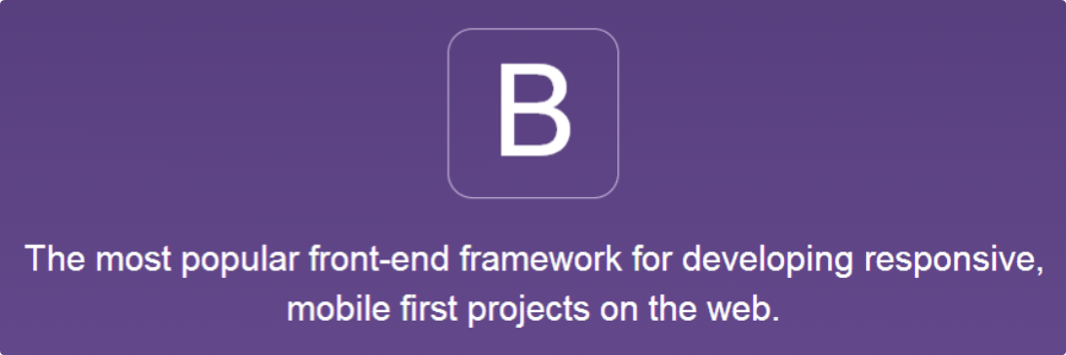
Table of Contents
Bootstrap Introduction
Getting Started with Bootstrap
Bootstrap Grid System

Slide 3
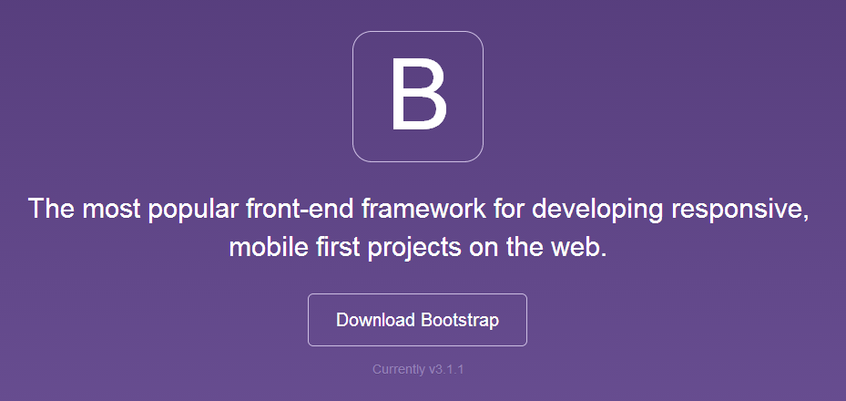
Bootstrap
Introduction

Slide 4
What is Bootstrap?
Bootstrap is a front-end framework for responsive Web sites
Developed by former Twitter employees (a.k.a. Twitter Bootstrap)
Open-source, available at GitHub: https://github.com/twbs/bootstrap
Dramatically simplifies the development of responsive sites
Built on 12-column fluid grid system
Manages most of your UI: typography, lists, tables, forms, buttons, images, navigations, alerts, pagination, panels, etc.
Official site: http://getbootstrap.com

Slide 5
Bootstrap Features
Grid system
12-column fluid grid system for phones / tablets / desktops
Predefined UI design CSS styles for the most page elements
Typography: headings, subheadings, fonts, colors, lists, etc.
Tables, forms and controls, buttons, image shapes, etc.
Components
Glyph icons, dropdowns, button groups, input groups, tabs, navigation bars (site headers), breadcrumps, pagers, labels, badges, jumbotrons (showcases), thumbnails, alerts, list groups, …

Slide 6

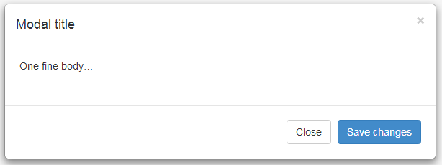
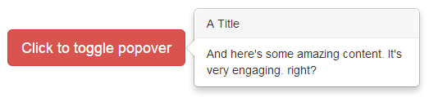
Bootstrap Features (2)
Bootstrap JavaScript extensions (jQuery plugins)
Modal popup dialogs
Tooltips and popovers
Alerts
Special buttons
Accordion
Carousel
Bootstrap themes: bootswatch.com, bootstrapzero.com, …

Slide 7
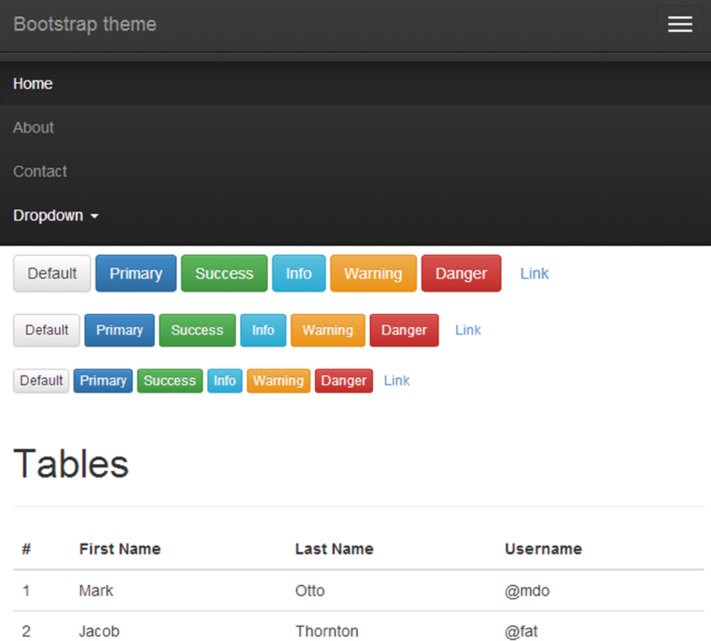
Bootstrap Components
Live Demo

Slide 8
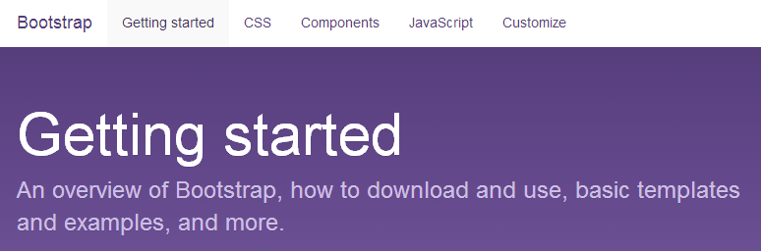
Bootstrap
Getting Started

Slide 9
Getting Started with Bootstrap
Download Bootstrap from:
http://getbootstrap.com/getting-started/#download
Creating and Bootstrap-based HTML page:
<head>
<link href="css/bootstrap.min.css" rel="stylesheet">
</head>
<body>
...
<script src="https://ajax.googleapis.com/ ajax/libs/jquery/1.11.0/jquery.min.js"></script>
<script src="js/bootstrap.min.js"></script>
</body>

Slide 10
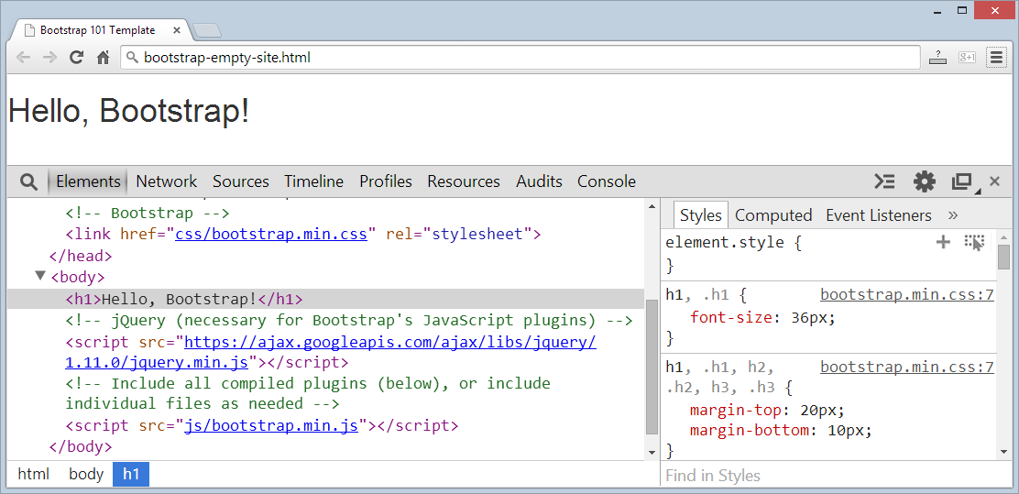
Getting Started with Bootstrap
Live Demo

Slide 11
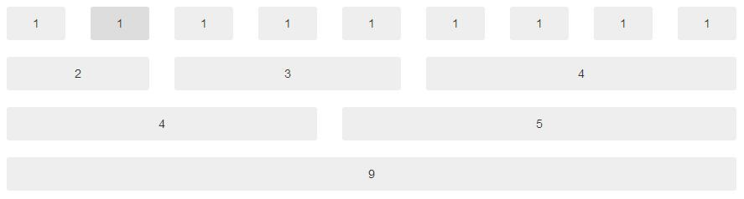
Bootstrap Grid System
Bootstrap includes a responsive, mobile first fluid grid system
Scales up to 12 columns as the screen size increases
Uses predefined CSS classes for layout

Slide 12
Bootstrap Screen Sizes
Bootstrap is designed to support 4 types of devices:
Extra small devices like smart phones (width < 768px) – xs
Small devices like tablets (width ≥ 768px) – sm
Medium devices like desktop computers (width ≥ 992px) – md
Large devices like large desktops (width ≥ 1200px) – lg
It may define column spans for different screen sizes
Show / hide columns (e.g. hide the sidebar n smart phones)
Done through CSS classes, no additional CSS, no JavaScript

Slide 13
Bootstrap Grid: CSS Classes
Put everything in .container > .row
Use .col-sm-9 to use 9 columns for tablets and larger screens
Use .col-lg-3 to use 3 columns for desktops and larger screens
<div class="container">
<div class="row">
<div class="col-sm-9">
Main Content</div>
<aside class="col-sm-3">
</div>
</div>
Tablet+
Main Content
Aside
(sm, md, lg)
Main Content
Smartphone
(xs)
Aside

Slide 14
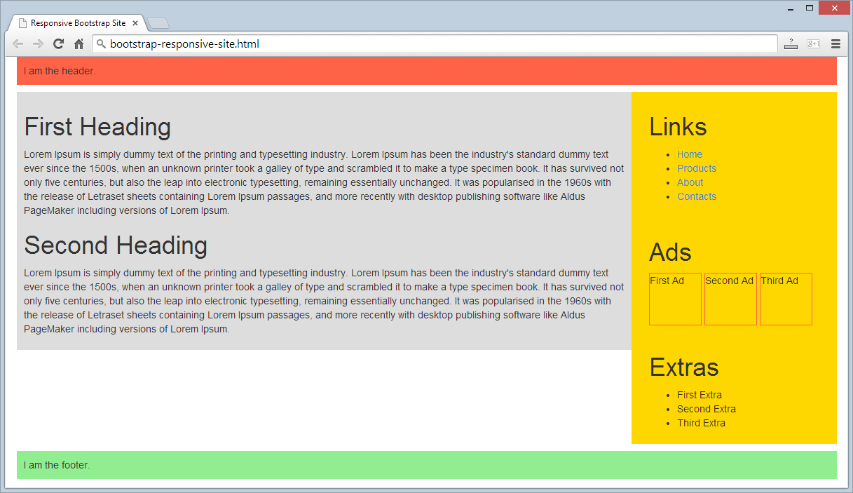
Bootstrap Grid System
Live Demo

Slide 15

Summary
Bootstrap
Powerful front-end framework for responsive Web sites
Defined ready-to-use CSS classes and UI components
Bootstrap fluid grid system
Use .container .row div
Use the .col-xs-5, .col-md-3, …

Slide 16
Bootstrap
https://softuni.bg/courses/web-fundamentals/

Slide 17
License
This course (slides, examples, demos, videos, homework, etc.) is licensed under the "Creative Commons Attribution-NonCommercial-ShareAlike 4.0 International" license
Attribution: this work may contain portions from
"HTML Basics" course by Telerik Academy under CC-BY-NC-SA license
"CSS Styling" course by Telerik Academy under CC-BY-NC-SA license

Slide 18







SoftUni Diamond Partners

Slide 19




Free Trainings @ Software University
Software University Foundation – softuni.org
Software University – High-Quality Education, Profession and Job for Software Developers
softuni.bg
Software University @ Facebook
facebook.com/SoftwareUniversity
Software University @ YouTube
youtube.com/SoftwareUniversity
Software University Forums – forum.softuni.bg

